Slide 1


Slide 2

The State of the Energy Industry, Impacts of COVID-19
Presentation for the American Association of Blacks in Energy (AABE)
Bill Graf and Paul Horak | May 27, 2020

Slide 3
This presentation contains general information only and Deloitte is not, by means of this presentation, rendering accounting, business, financial, investment, legal, tax, or other professional advice or services. This presentation is not a substitute for such professional advice or services, nor should it be used as a basis for any decision or action that may affect your business. Before making any decision or taking any action that may affect your business, you should consult a qualified professional advisor. Deloitte shall not be responsible for any loss sustained by any person who relies on this presentation.

Slide 4

Bill Graf Partner, Deloitte & Touche
Bill Graf is a partner in the Chicago office of Deloitte & Touche and the US Firm’s National Professional
Practice Director and Industry Leader for the Power & Utility Industry. In more than 35 years of service to
the energy industry, Bill has provided audits of financial statements, expert witness testimony in
regulatory proceedings, due diligence on energy company acquisitions, depreciation studies, and control
issue consultation for energy companies . Bill also serves as the lead client service partner, advisory
partner and concurring reviewer on many of D&T’s large utility clients. He has provided training on
regulatory and accounting matters to companies, industry groups and regulatory agencies, such as the
Edison Electric Institute, American Gas Association and the Federal Energy Regulatory Commission. Bill
has published extensively on accounting for energy companies.

Slide 5
Focus on Power, Utilities, and Renewables sector

Slide 6
Evolving electricity demand patterns create uncertainty
Electricity demand has started weakening and grid operators are assessing long-term impact
Average daily peak load in selected regional power markets
has fallen in 2020 vs. 2019 (through April 21)
Electricity demand hits 17-year low
Electricity sales volume has declined due to work and travel restrictions in the US. In the week starting April 13, power demand fell to its lowest weekly level since May 2003 and was down 4.2% from the same week in 2019.¹
Regional operators assessing long-term impacts
Many regional operators reported weekly demand reductions 8-9% below the prior year through the second week of April 2020, though they are still assessing long-term impacts.² From late March through April, weekday NYISO daily electricity demand averaged about 13% below temperature-comparable historical demand, 16% in New York City.³
Muted FY20 electricity forecasts
EIA’s short-term energy outlook forecasts U.S. electricity consumption to decline by 6.5 percent year-over-year in 2020 in both the commercial and the industrial sectors, while residential demand is expected to decline by 1.6 percent. Overall decline would be 4.5 percent.⁴
Source: Platts, S&P Global
Suspension of disconnects and other costs create bottom-line uncertainty, though regulatory mechanisms could provide some cushion
Utility late fee waivers and suspension of disconnects may lead to increased bad debt, and other incremental costs of responding to the crisis will likely affect utility revenue. However, in many states utilities may be able to recover bad debt expenses in future rate cases.
Independent power producers and merchant generators with no regulatory rates protection would have significant exposure to non-payment that would likely occur during a severe recession.
In a mid-April survey, 7 percent of consumers said they either had skipped or intended to skip an electric or gas bill payment during the COVID-19 crisis and 13 percent said they didn’t know if they would skip a payment.⁵
Notes:
Sources
¹ Jared Anderson et al, “COVID-19-related load impacts are being reported by several US grid operators”, S&P Global, March 23, 2020 2 E Aidan Tuohy et al, “COVID-19 Bulk System Impacts Demand Impacts and Operational and Control Center Practices”, Electric Power Research Institute, March 27,2020 3 Mark Watson, “Pandemic causing 8%-9% power demand decrease nationwide,” S&P Global, April 22, 2020, 4 “COVID-19 and the Electric Grid: Load Shifts as New Yorkers Respond to Crisis,” NYISO, April 14, 2020, 5 Catherine Morehouse, “Wisconsin regulators launch investigation into COVID-19 related costs for utilities”, Utility Dive, March 31,2020 6 Edison Electric Institute, “Helping customers during this time of need: All EEI member companies suspend electricity disconnects,” March 19, 2020
https://www.greentechmedia.com/articles/read/california-renewable-curtailments-spike-as-coronavirus-reduces-demand?ite=33564&ito=2122&itq=8a088f50-ea02-415b-a500-500ce70eb732&itx%5Bidio%5D=70605
https://www.spglobal.com/platts/en/market-insights/latest-news/electric-power/032320-covid-19-related-load-impacts-are-being-reported-by-several-us-grid-operators
https://www.spglobal.com/platts/en/market-insights/latest-news/electric-power/040120-factbox-power-demand-prices-begin-to-slip-as-coronavirus-stay-home-orders-spread
https://www.utilitydive.com/news/wisconsin-regulators-launch-investigation-into-covid-19-related-costs-for-u/575148/
Securitization allows the company to segregate the regulatory asset into a special purpose entity, or SPE, that is bankruptcy remote. The SPE issues bonds to cover the asset in one lump sum that is remitted to the utility. Debt service on the bonds is collected from ratepayers through a non-bypassable charge that the state agrees it will not rescind under any circumstances. As a result, the bonds generally carry the highest investment grade credit rating and the lowest interest rates; thus reducing the overall cost to ratepayers by lowering the financing costs on the assets relative to the company's overall cost of capital.
^{Sources:}
^{1 S&P, sourced from SNL}
5 out of 8 regional markets already saw demand drop in Jan and Feb compared to the 5-year average (see chart at right) and are seeing deeper declines in March. Some of the most recent declines may be partly related to COVID 19’s impact

Slide 7
Capital is still accessible, but spending plans may be revisited
Capital market access continues for now, but projects may be impacted by the pandemic and economic downturn
US energy utility actual
capital expenditures ($ Billion)
COVID-19 will likely slow utility CAPEX momentum
Utilities may make downward revisions to short-term capital spending due to credit market and economic uncertainty as well as slower demand forecasts, but will likely continue to target long-term total capital investments.
U.S. utility capex declined by 4% in 2009 due to recessionary pressures and weak economic conditions. However, utilities returned to a more aggressive spending posture as economic conditions stabilized.
Grid modernization likely to be key spending category
T&D will likely remain a major component of utility capex programs given the need for investments to replace and modernize aging infrastructure, connect new generation sources, service any new pockets of demand, and maintain reliability and resilience.
Source: S&P Global Market Intelligence as of Oct 2019
Most utilities will likely have sufficient liquidity to get through the year. However, the depth and duration of the economic slowdown will likely be a key variable
Some large IOUs issued billions in debt in late March and early April to ensure liquidity and demonstrate access to capital after stock market volatility.
Utilities raised over $20 billion in US investment-grade debt in March and some announced multimillion or billion-dollar debt offerings in early April. Access appears easier than in the 2008-9 credit crisis.⁶
While electricity projects are deemed critical by the federal government, as the economy enters a recession, it’s unclear whether some capital projects will be delayed or postponed.
Some IOUs have said the pandemic may disrupt their business in unprecedented ways and create financial and operational issues that a recession would exacerbate further.⁷
Notes:
Sources
https://platform.mi.spglobal.com/web/client?auth=inherit&overridecdc=1&#news/article?id=58150776&KeyProductLinkType=17
https://investors.centerpointenergy.com/news-releases/news-release-details/centerpoint-energy-announces-measures-strengthen-financial

Slide 8
Construction and supply delays impact renewables in short-term
Renewable projects face some delays, but long-term growth likely to continue
Utility solar projects face construction delays, while rooftop solar sees cancellations
Supply delays combined with construction disruptions will likely lead to up to 5 GW of utility-scale solar project delays out of a total of approximately 15 GW of projects.⁸
Some rooftop solar companies have seen 30% of their bookings canceled or postponed due to shelter-in-home mandates and economic uncertainty.⁹
Renewable project risks
Shipping delays from potential U.S. port closings
4
Travel delays limiting project milestones
3
Component supply risks due to production halts
US wind encounters unique challenge
The requirement for developers to complete projects that qualified for the full Production Tax Credit (PTC) by the end of 2020 was expected to push industry limits, though Treasury Dept. plans to extend the safe harbor deadline may help.
Field personnel absences and social distancing
Site shutdowns due to state shelter-in-home orders*
But current delays unlikely to impact long-term growth
While renewable growth will likely slow in the short term, the longer term growth trajectory will likely continue due to low costs, rapid construction timelines, supportive government policies, and customer preferences for cleaner energy sources.
* Partly mitigated as the Department of Homeland Security classifies wind and solar project construction as essential business
Financing renewable projects
The nature of renewable energy tax credits, the wind PTC and solar ITC, makes developers reliant on a relatively limited number of investors willing to provide tax equity for projects. However, utility-scale projects are currently signing up both construction and tax equity financing.
The pool of potential capital may be impacted in the future by possible financial market declines and volatility.
Volatility in other commodity markets has made renewables attractive due to their comparatively low-risk, stable yield. For example, renewable projects are now seeing a higher return than some oil and gas investments.
Notes:
Sources
¹ Ravi Manghani, “Coronavirus Could Delay Construction of 5 Gigawatts of US Utility-Scale Solar”, Greentech Media April 2, 2020
² Michael Copley, “Coronavirus disruptions could delay 25% of US solar installations,” SNL, April 1,2020
³ Karl-Erik Stromsta, “For Wind and Solar Sectors, Biggest Coronavirus Risk May Be a Damaged Economy”, Greentech Media, March 15, 2020

Slide 9
Additional Considerations
Financial Reporting and Internal Control
Issues around Accounting, Disclosure and SEC Reporting and Internal Control
Companies will be incurring incremental costs and experiencing lost revenues for a certain period of time. Each will have to evaluate the unique circumstances around the ability to record a regulatory asset for future collection.
Due to disconnect moratoriums and reconnect mandates, companies will evaluate revenue collectability and the sufficiency of the bad debt reserves.
Potential considerations required around asset (including goodwill) impairment, pension demographics, derivative evaluations, among others.
Evaluation of the sufficiency of disclosure in Risk Factors, MD&A and notes to the financial statements.
Because of the impact of COVID-19, entities may need to implement new internal controls or modify existing ones. Any changes in internal controls that have materially affected, or are reasonably likely to materially affect, entities’ internal control over financial reporting must be disclosed in Item 4 of Form 10-Q or Item 9A of Form 10-K, of entities’ quarterly or annual filings, respectively (or Item 15 of Form 20-F for foreign private issuers).
Regulatory
Considerations
Interaction with the Regulatory Commission during this time is critical
The pace of electric and natural gas utility rate case filings slowed considerably in recent weeks as the coronavirus pandemic prompted companies to divert their focus to more pressing matters. Case filing data is a clear anomaly and imply that logistical constraints associated with many organizations' transitions to remote operations could be a factor that led to the sharp drop in filing activity.
There is also an apparent reluctance of utilities to file rate cases at a time when many customers are experiencing hardships.
There is significant activity involving legislation or commission orders providing for the deferral of certain COVID-19 costs and lost revenues. Many of the provisions call for deferral with review in the future.
The impact of COVID-19 also creates the potential for deferral or reconfiguration of local initiatives as well as certain opposition protesting.
Notes:
¹ Sanders and John Hawkins, “Navigating the new normal – Addressing employee experience during COVID-19,” Forbes, March 27, 2020;
Anne Fisher, “How Eventbrite employees are connecting—and becoming more productive—during the coronavirus,” Fortune, March 28, 2020
https://www.spglobal.com/marketintelligence/en/news-insights/latest-news-headlines/us-utilities-expected-to-see-muted-impact-from-covid-19-in-q1-20-results-58153257

Slide 10
Additional Considerations
Operational Issues
The PU&R industry focuses on reliability and resiliency as it faces uncertainties
Each company is prioritizing the safety of employees and maximizing remote working capabilities. Critical and essential operations and employees have been identified and procedures put in place for protection—including isolation and sequestration when necessary.
Critical supply chain issues include procurement of fuel and inventory, construction and capital materials, PPE and cleaning materials—among others. The supply chain bottlenecks could be either international or domestic issues.
Social distancing impacts utility employees answering maintenance calls, emergency disruption, meter reading and construction sites.
Based on the increased remote working environment, COVID-19 has increased the attack surface for utilities—enhancing the risk and attention that must be paid to cyber security.
The Electricity Subsector Coordinating Council has produced a Resource Guide entitled Assessing and Mitigating the Novel Coronavirus (COVID-19). This document is a resource for electric power industry leaders to guide informed localized decisions in response to the COVID-19 global health emergency. It highlights data points, stakeholders, and options to consider in making decisions about operational status, while protecting the health and safety of employees, customers, and communities.
Notes:
¹ Sanders and John Hawkins, “Navigating the new normal – Addressing employee experience during COVID-19,” Forbes, March 27, 2020;
Anne Fisher, “How Eventbrite employees are connecting—and becoming more productive—during the coronavirus,” Fortune, March 28, 2020
https://www.spglobal.com/marketintelligence/en/news-insights/latest-news-headlines/us-utilities-expected-to-see-muted-impact-from-covid-19-in-q1-20-results-58153257

Slide 11
Endnotes
¹ Scott DiSavino, “U.S. Power Demand Falls to 16-Year Low as Coronavirus Cuts Use by Companies,” Reuters, April 8, 2020.
² Mark Watson, “Pandemic causing 8%-9% power demand decrease nationwide,” S&P Global Platts, April 22, 2020.
³ April Lee, Jonathan DeVilbiss, "Daily electricity demand in New York falls about 13% after COVID-19 mitigation efforts," EIA, May 6, 2020.
⁴ EIA, “Short-term energy outlook.”
⁵ Omar Siddiqui and Min Long, “Impact of COVID-19 on Consumer Energy Use & Outlook: Results of EPRI National Survey,” Electric Power Research
Institute, April 29, 2020, p. 7.
⁶ Ellen Meyers, “US utilities demonstrate access to capital with billions in debt offerings,” S&P Global Market Intelligence, April 2, 2020.
⁷ Darren Sweeney, “Too early to tell': US utilities try to anticipate potential recession impacts,” S&P Global Market Intelligence, March 27, 2020.
⁸ Ravi Manghani, “Coronavirus could delay construction of 5 gigawatts of US utility-scale solar,” Greentech Media, April 2, 2020.
⁹ Michael Copley, “Coronavirus disruptions could delay 25% of US solar installations,” S&P Global Market Intelligence, April 1, 2020.
¹

Slide 12
Focus on Oil and Gas sector

Slide 13

Paul L. Horak Partner, Audit and Enterprise Risk Services US Oil and Gas Audit Leader
Paul has over 29 years of experience in providing audit and accounting services, primarily for oil and gas clients. His experience includes consultation on transactions, such as acquisitions, divestitures and equity and debt offerings, and compliance with Section 404 of the Sarbanes-Oxley Act. As an Advisory Partner, he understands the need for extensive communication, planning and monitoring to achieve a well-coordinated, successful relationship.

Slide 14
Two black swan events hit the O&G industry simultaneously
The COVID-19 pandemic and an oil price war among producers led to a precipitous fall in oil demand and prices
Interplay between rising COVID-19 cases and WTI prices
Monthly change in global oil demand (2020)
(As of May 15, 2020)
(Over pre-pandemic levels)
Actuals
Projected
Supply disagreement between Saudi and Russia and growing COVID-19 cases worldwide adversely impacted WTI prices & even pushed May futures into negative ($-37/bbl) for a while.
Lockdown of nations worldwide led to about 30% fall in oil demand in April. Even in May, global demand is projected to fall by 20% over its pre-pandemic levels.
Sources: Worldometer, US Energy Information Administration; Rystad Energy

Slide 15
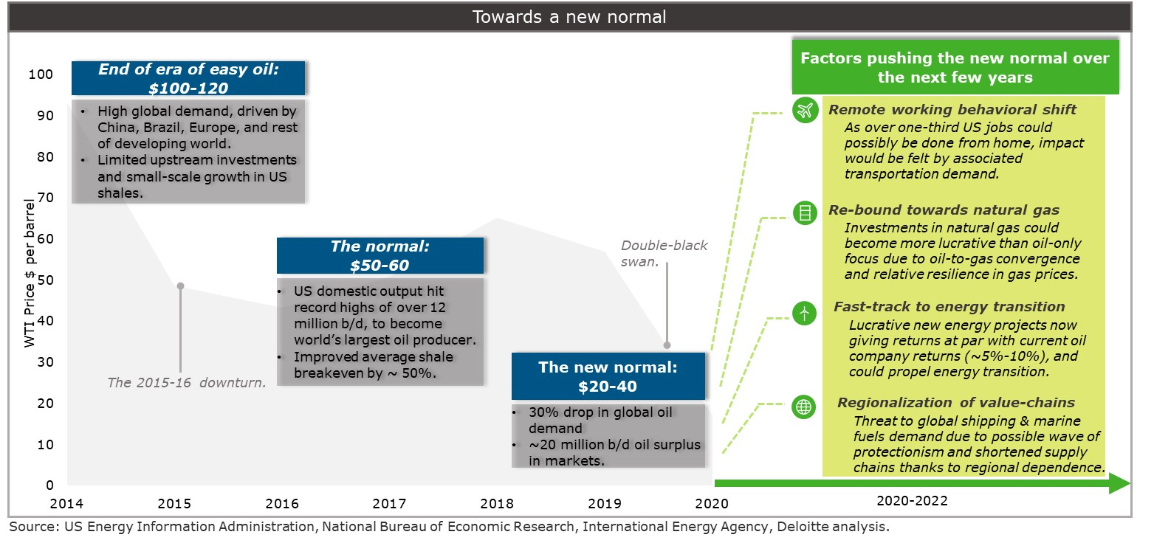
A new normal awaits the O&G industry
The new telecommuting norm or behavioral shift of consumers is expected to structurally impact oil’s demand, leading to a new normal of lower oil prices of $20-40/bbl over the next couple of years

Slide 16
Meanwhile, an economic storm has been brewing for US shale operators
Highest disconnect between the net present values of estimated future cash flows, carrying (book) value of reserves, and market capitalization of US shale operators to trigger significant bankruptcies in 2020
Financial state of major shale operators under two price scenarios
The shortfall between NPV of operators’ future cash flows ($35/bbl) and their carrying value of reserves is about $300 billion, and could translate into significant resource impairments and asset write-offs initially.
In-fact, asset impairments could reach 2015 levels, and these non-cash accounting adjustments could mean substantial write-offs from shareholders’ equity.
The result: an immediate increase in the industry’s leverage ratio from 40 percent to 54 percent, triggering a destructive sequence of events such as mass bankruptcies.
Notes:
SEC values represent net present value of future cash flows reported by companies in their 10-K SEC filings.
SEC values for 2020 are calculated by applying the change in oil prices under two oil price scenarios for the next 3 years ($35/bbl and $20/bbl) over 2019 realized prices, assuming all other things constant. Natural gas and NGL prices are adjusted accordingly.
Source: Deloitte analysis based on data accessed from Capital IQ database.

Slide 17
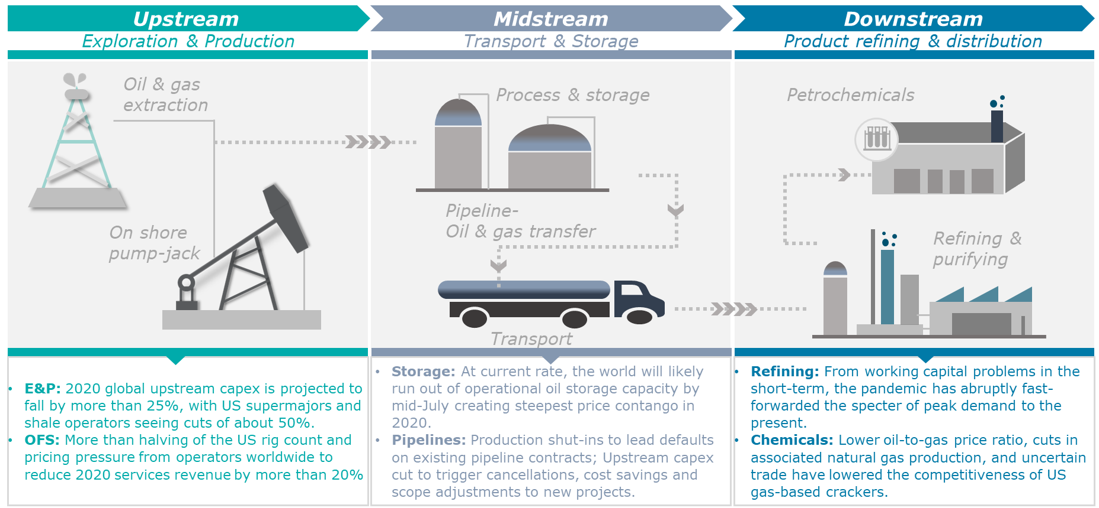
Impact on upstream has a domino impact on the entire oil and gas value chain
While E&Ps have been hit the hardest, sustainability across the value chain has come under scrutiny
Source: Wood Mackenzie, Rystad Energy, EIA, Deloitte analysis.

Slide 18







Finding opportunity in crisis for the industry
Time for some serious tactical and strategic action to maneuver through the trying times
Unlocking full capital potential
Re-aligning cost allocations
Freeing locked-up capital by divesting non-core assets and building capital optionality.
Establishing a quick diagnostic, and disciplined cost approach to set strategic grounding for cost transformation.
Re-visiting M&A for structural upgrade
Achieving operational excellence from breakthrough innovation
Creating new synergies through operationally and financially strong consolidation.
Building an operational-technology driven enterprise by integrating advanced, risk analytics with operational breakthroughs.
Establishing strategic integration across value chain
Finding value in sustainability as a business
Building a secured supply chain with built-in contingency plans to realize shared benefits through agile contracting models.
Making new energy competitive by expanding existing KPIs and proactive ESG reporting, to make sustainability a way of business.

Slide 19
About Deloitte Deloitte refers to one or more of Deloitte Touche Tohmatsu Limited, a UK private company limited by guarantee (“DTTL”), its network of member firms, and their related entities. DTTL and each of its member firms are legally separate and independent entities. DTTL (also referred to as “Deloitte Global”) does not provide services to clients. In the United States, Deloitte refers to one or more of the US member firms of DTTL, their related entities that operate using the “Deloitte” name in the United States and their respective affiliates. Certain services may not be available to attest clients under the rules and regulations of public accounting. Please see www.deloitte.com/about to learn more about our global network of member firms.
Copyright © 2020 Deloitte Development LLC. All rights reserved.

Slide 20
The State of the Energy Industry, Impacts of COVID-19
Presentation for the American Association of Blacks in Energy (AABE)
Bill Graf and Paul Horak | May 27, 2020

